Slide 1

SOFTWARE ENGINEERING AND PROJECT MANAGEMENT (CSE 227)
Department of Computer Science and Engineering
School of Engineering,
PRESIDENCY UNIVERSITY

Slide 2
CHAPTER 6 & 7 DESIGN CONCEPTS & architectural design
Department of Computer Science and Engineering
School of Engineering, Presidency University

Slide 3
Module 2: Software Requirements and Design (9 hrs.) – Comprehension level
Requirements Engineering: Eliciting requirements, Functional and non- Functional requirements, SRS, Requirements modelling: Developing Use Cases, Developing Activity diagram and Swim lane diagram, Design : Design concepts, Architectural design, Component based design, User interface design.

Slide 4
Chapter 6 – Design Concepts
What is Design?
Analysis to Design transition
Quality Guidelines
Design Principles
Fundamental Design Concepts
Abstraction
Software Architecture
Separation of Concerns
Modularity
Functional Independence – Cohesion and Coupling
OO Design Concepts
Design Model and Elements

Slide 5
Chapter 7 – Architectural Design
What is Software Architecture
Importance of Software Architecture
Architectural Styles
Data-centered Architectures
Data Flow Architecture
Call and Return Architecture
Layered Architecture
Architectural Patterns
Concurrency
Persistence
Distribution
Architecture Partitioning

Slide 6
1. What is Design
Software design is the process by which an agent creates a specification of a software artifact, intended to accomplish goals, using a set of basic components and subject to constraints.
Good software design should exhibit:
Firmness: A program should not have any bugs that inhibit its function.
Commodity: A program should be suitable for the purposes for which it was intended.
Delight: The experience of using the program should be pleasurable one.

Slide 7
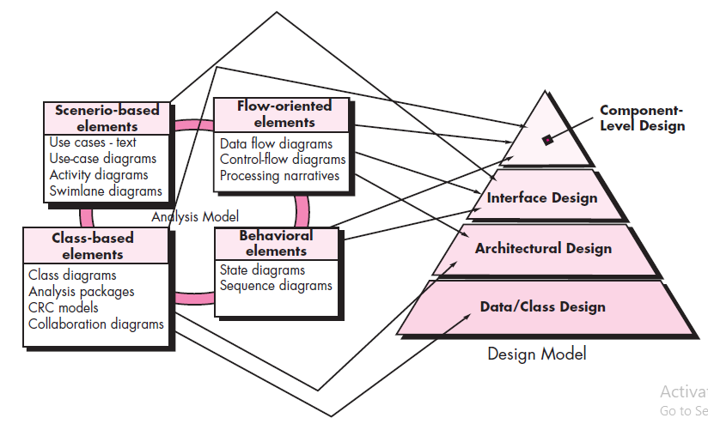
2. Analysis to Design Model Transition

Slide 8
Design and Quality
Design must implement all of the explicit requirements contained in the analysis model, and it must accommodate all of the implicit requirements desired by the customer.
Design must be a readable, understandable guide for those who generate code and for those who test and subsequently support the software.
Design should provide a complete picture of the software, addressing the data, functional, and behavioral domains from an implementation perspective.

Slide 9
3. Quality Guidelines
A design should exhibit an architecture that (1) has been created using recognizable architectural styles or patterns, (2) is composed of components that exhibit good design characteristics and (3) can be implemented in an evolutionary fashion
For smaller systems, design can sometimes be developed linearly.
A design should be modular; that is, the software should be logically partitioned into elements or subsystems
A design should contain distinct representations of data, architecture, interfaces, and components.
A design should lead to data structures that are appropriate for the classes to be implemented and are drawn from recognizable data patterns.

Slide 10
Quality Guidelines
A design should lead to components that exhibit independent functional characteristics.
A design should lead to interfaces that reduce the complexity of connections between components and with the external environment.
A design should be derived using a repeatable method that is driven by information obtained during software requirements analysis.
A design should be represented using a notation that effectively communicates its meaning.

Slide 11
4. Design Principles
The design should be traceable to the analysis model.
The design should not reinvent the wheel.
The design should “minimize the intellectual distance” between the software and the problem as it exists in the real world.
The design should exhibit uniformity and integration.
The design should be structured to accommodate change.
The design should be structured to degrade gently, even when aberrant data, events, or operating conditions are encountered.
Design is not coding, coding is not design.
The design should be assessed for quality as it is being created, not after the fact.
The design should be reviewed to minimize conceptual (semantic) errors.
From Davis [DAV95]

Slide 12
5. Fundamental Concepts
Abstraction - data, procedure, control
Architecture - the overall structure of the software
Separation of concerns - any complex problem can be more easily handled if it is subdivided into pieces
Modularity - compartmentalization of data and function
Functional independence - single-minded function and low coupling
Design Classes - provide design detail that will enable analysis classes to be implemented

Slide 13
5.1 Data Abstraction
door
manufacturer
model number
type
swing direction
inserts
lights
type
number
weight
opening mechanism
implemented as a data structure

Slide 14
Procedural Abstraction
open
details of enter
algorithm
implemented with a "knowledge" of the
object that is associated with enter

Slide 15
5.2 Software Architecture
Software architecture refers to the high level structures of a software system and the discipline of creating such structures and systems.
Each structure comprises:
Software elements
Relations among the elements
Properties of both elements and relations

Slide 16
5.3 Separation of Concerns
Any complex problem can be more easily handled if it is subdivided into pieces that can each be solved and/or optimized independently
A concern is a feature or behavior that is specified as part of the requirements model for the software
By separating concerns into smaller, and therefore more manageable pieces, a problem takes less effort and time to solve.

Slide 17
5.4 Modularity
“Modularity is the single attribute of software that allows a program to be intellectually manageable”.
Monolithic software (i.e., a large program composed of a single module) cannot be easily grasped by a software engineer.
The number of control paths, span of reference, number of variables, and overall complexity would make understanding close to impossible.
In almost all instances, you should break the design into many modules, hoping to make understanding easier and as a consequence, reduce the cost required to build the software.

Slide 18
Modularity Trade-Offs
What is the "right" number of modules
for a specific software design?
module development cost
cost of
software
module
integration
cost
number of modules

Slide 19
5.5 Functional Independence
Functional independence is achieved by developing modules with "single-minded" function and an "aversion" to excessive interaction with other modules.
Cohesion is an indication of the relative functional strength of a module.
A cohesive module performs a single task, requiring little interaction with other components in other parts of a program. Stated simply, a cohesive module should (ideally) do just one thing.
Coupling is an indication of the relative interdependence among modules.
Coupling depends on the interface complexity between modules, the point at which entry or reference is made to a module, and what data pass across the interface.

Slide 20
5.6 OO Design Concepts
Design classes
Entity classes
Boundary classes
Controller classes
Inheritance - all responsibilities of a superclass is immediately inherited by all subclasses
Messages - stimulate some behavior to occur in the receiving object
Polymorphism - a characteristic that greatly reduces the effort required to extend the design

Slide 21
Design Classes
Analysis domain classes are refined during design to become entity classes
Boundary classes are developed during design to create the interface (e.g., interactive screen or printed reports) that the user sees and interacts with as the software is used.
Boundary classes are designed with the responsibility of managing the way entity objects are represented to users.
Controller classes are designed to manage
the creation or update of entity objects;
the instantiation of boundary objects as they obtain information from entity objects;
complex communication between sets of objects;
validation of data communicated between objects or between the user and the application.

Slide 22
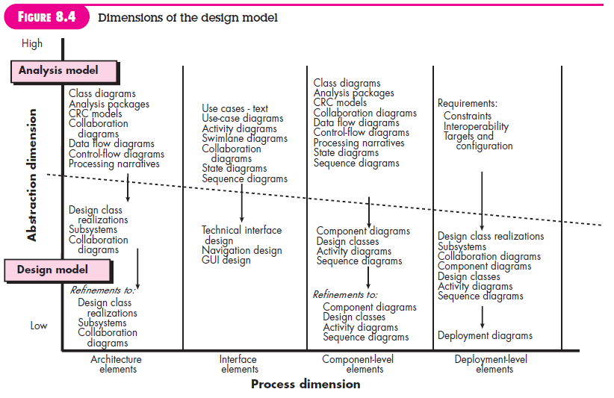
5.7 The Design Model

Slide 23
Design Model Elements
Data elements
Data model --> data structures
Data model --> database architecture
Architectural elements
Application domain
Analysis classes, their relationships, collaborations and behaviors are transformed into design realizations
Patterns and “styles”
Interface elements
the user interface (UI)
external interfaces to other systems, devices, networks or other producers or consumers of information
internal interfaces between various design components.
Component elements
Deployment elements

Slide 24
Architectural Design
IEEE defines architectural design as “the process of defining a collection of hardware and software components and their interfaces to establish the framework for the development of a computer system.” The software that is built for computer-based systems can exhibit one of these many architectural styles.
Each style will describe a system category that consists of :
A set of components(eg: a database, computational modules) that will perform a function required by the system.
The set of connectors will help in coordination, communication, and cooperation between the components.
Conditions that how components can be integrated to form the system.
Semantic models that help the designer to understand the overall properties of the system.

Slide 25
Architectural Design 1.1 Software Architecture
The software architecture of a program or computing system is the structure or structures of the system, which comprise software components, the externally visible properties of those components, and the relationships among them.
1.2 Importance of Software Architecture
Representations of software architecture are an enabler for communication between all parties (stakeholders) interested in the development of a computer-based system.
The architecture highlights early design decisions that will have a profound impact on all software engineering work that follows and, as important, on the ultimate success of the system as an operational entity.
Architecture “constitutes a relatively small, intellectually graspable mode of how the system is structured and how its components work together”

Slide 26
1.3 Architectural Styles
An architectural style is a transformation that is imposed on the design of an entire system.
Each style describes a system category that encompasses:
(1) Set of components (e.g., a database, computational modules) that perform a function required by a system
(2) Set of connectors that enable “communication, coordination and cooperation” among components
(3) Constraints that define how components can be integrated to form the system, and
(4) Models that enable a designer to understand the overall properties of a system by analyzing the known properties of its constituent parts.

Slide 27
Types of Architectural Styles
Data-centered architectures
Data flow architectures
Call and return architectures
Object-oriented architectures
Layered architectures

Slide 28
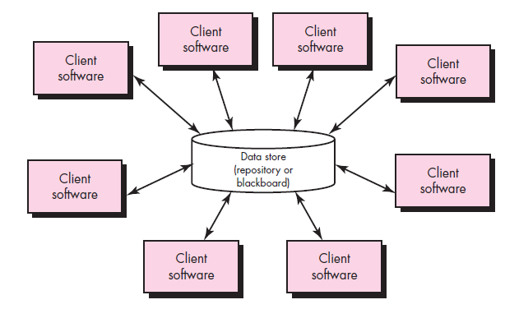
Data-Centered Architectures

Slide 29
A data store will reside at the center of this architecture and is accessed frequently by the other components that update, add, delete or modify the data present within the store.
The figure illustrates a typical data centered style. The client software access a central repository. Variation of this approach are used to transform the repository into a blackboard when data related to client or data of interest for the client change the notifications to client software.
This data-centered architecture will promote inerrability. This means that the existing components can be changed and new client components can be added to the architecture without the permission or concern of other clients.
Data can be passed among clients using blackboard mechanism.

Slide 30
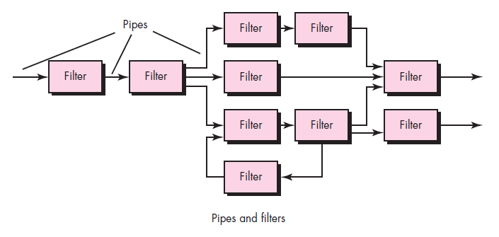
Data Flow Architectures

Slide 31
This kind of architecture is used when input data to be transformed into output data through a series of computational manipulative components.
The figure represents pipe-and-filter architecture since it uses both pipe and filter and it has a set of components called filters connected by pipes.
Pipes are used to transmit data from one component to the next.
Each filter will work independently and is designed to take data input of a certain form and produces data output to the next filter of a specified form. The filters don’t require any knowledge of the working of neighboring filters.
If the data flow degenerates into a single line of transforms, then it is termed as batch sequential. This structure accepts the batch of data and then applies a series of sequential components to transform it.

Slide 32
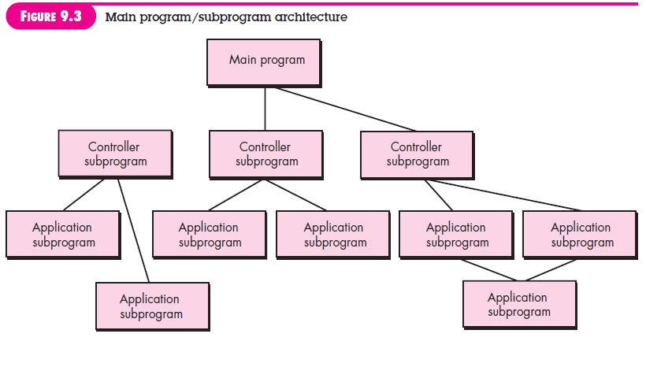
Call and Return Architectures

Slide 33
Call and Return architectures: It is used to create a program that is easy to scale and modify. Many sub-styles exist within this category. Two of them are explained below.
Remote procedure call architecture: This components is used to present in a main program or sub program architecture distributed among multiple computers on a network.
Main program or Subprogram architectures: The main program structure decomposes into number of subprograms or function into a control hierarchy. Main program contains number of subprograms that can invoke other components.

Slide 34
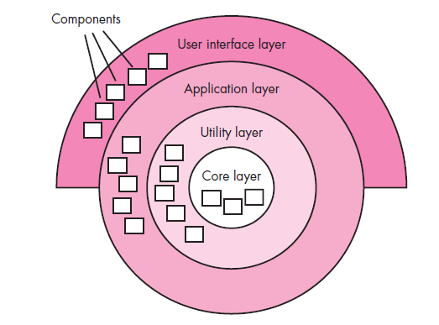
Layered Architectures

Slide 35
A number of different layers are defined with each layer performing a well-defined set of operations. Each layer will do some operations that becomes closer to machine instruction set progressively.
At the outer layer, components will receive the user interface operations and at the inner layers, components will perform the operating system interfacing(communication and coordination with OS)
Intermediate layers to utility services and application software functions.

Slide 36
4. Architectural Patterns
Architectural patterns address an application-specific problem within a specific context and under a set of limitations and constraints.
The pattern proposes an architectural solution that can serve as the basis for architectural design.

Slide 37
Architectural Patterns
Concurrency - applications must handle multiple tasks in a manner that simulates parallelism
operating system process management pattern
task scheduler pattern
Persistence - Data persists if it survives past the execution of the process that created it. Two patterns are common:
a database management system pattern that applies the storage and retrieval capability of a DBMS to the application architecture
an application level persistence pattern that builds persistence features into the application architecture
Distribution - the manner in which systems or components within systems communicate with one another in a distributed environment
A broker acts as a ‘middle-man’ between the client component and a server component.

Slide 38
5. Partitioning the Architecture
Partitioning can be done “Horizontally” or “Vertically”

Slide 39
Horizontal Partitioning
Define separate branches of the module hierarchy for each major function
Use control modules to coordinate communication between functions
function 1
function 3

Slide 40
Vertical Partitioning
Design so that decision making and work are stratified
Decision making modules should reside at the top of the architecture
decision-makers
workers

Slide 41
Why Data Partitioning
Results in software that is easier to test
Leads to software that is easier to maintain
Results in propagation of fewer side effects
Results in software that is easier to extend

